Slide 1
Capstone Project-3
Supervised Machine Learning -Classification
Credit Card Default Prediction
Done by:
Shadab Husain

Slide 2

Content
Problem Statement
Introduction
Features Summary
Data Cleaning
Import libraries
Exploratory Data Analysis
Transformation of Data
Splitting Data
Fitting Different Model
Cross Validation &
Hyperparameter Tunning
Comparison of Model
Conclusion

Slide 3
Problem Statement:
*Predicting whether a customer will default on his/her credit
card.
* Understand, and prepared the data and make it ready for
training.
* Understand the target column and its distribution
* Evaluating target features for class imbalance.
* Modeling
* Evaluation while keeping class imbalance in mind.
* Feature Importance and Conclusion

Slide 4
Introduction
As more and more consumers depend on on the credit card to pay their everyday purchases in online and physical retail store, the amount of issued credit cards and the overpowering amount of credit card debt by the cardholders have quickly increased. Therefore, most financial institutions have to deal with the issues of credit card default in addition to the credit card fraud .
In this project, we have built a machine learning model that predicts whether a assured individual will be a defaulter. This prediction is inclined by a variety of features which we will be exploring in subsequent sections. Credit risk of an specific can be calculated based on a number of factors such as - age, gender, education, employment status and marital status, etc.

Slide 5
Features Summary
ID: Unique ID of each client
LIMIT_BAL: Amount of the given credit (NT dollar)
Gender: Gender of customer. (1 = male; 2 = female)
Education: Education qualification of customers
(1 = graduate school; 2 = university; 3 = high school; 4 = others)
Marital Status: Marital status of customer. (1 = married; 2 = single; 3 = others)

Slide 6
Age: Age of customer in years.
History of Past Payment: (PAY) Repayment status in September, August,
July, June, May and April 2005.
Amount of Bill Statement: (BILL_AMT) Amount of bill statement in
September, August, July, June, May and April 2005.
Amount of Previous Payment: (PAY_AMT) Amount of previous
payment in September, August, July, June, May and April 2005.

Slide 7

Data Cleaning
We analyzed the dataset for duplicate values, null values, missing values and it was observed that the data showed absence of any such data which means that there were no duplicate, missing or null values present in the given dataset.

Slide 8
Import libraries
Numpy
Pandas
Matplotlib
Seaborn
Sklearn

Slide 9
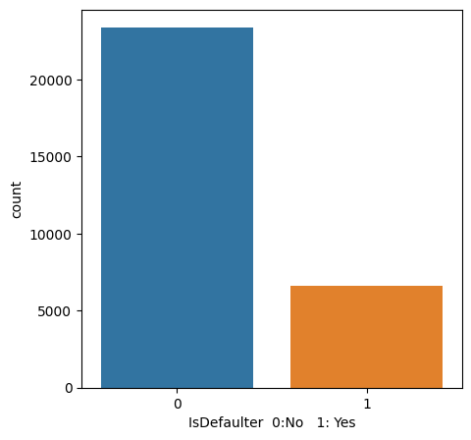
Exploratory Data Analysis
IsDefaulter(0=No,1=Yes)
About more than 5000 of the payments are default.
Defaulters are in a small amount as compare to the Non-Defaulters in the given dataset
Both the classes are not in fraction which means we have an unfair dataset.

Slide 10
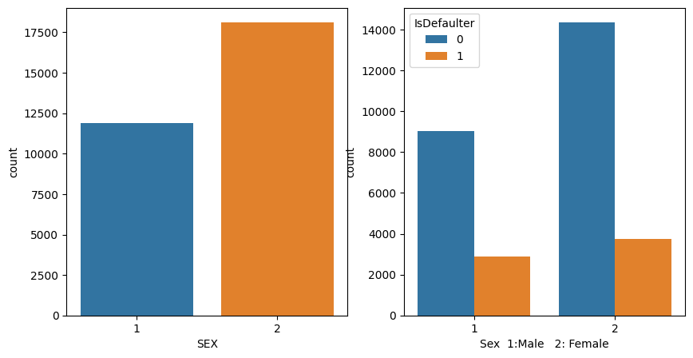
EDA (Continued)
It shows the difference between male and female default ratio.
It is clear that female lean towards to have more defaults than male. Females are the major user of credit cards.
Females creates the major revenue for credit cards and Banks need to create some new policies to reduce the defaults.

Slide 11
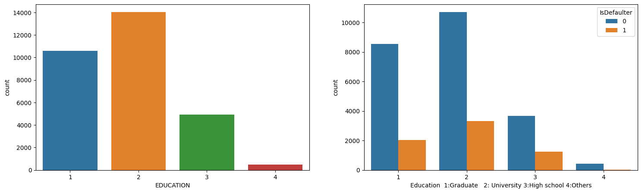
EDA (Continued)
It shows the well-educated group that mostly found to default
University and graduate school has maximum credit card holder.
As the number of university and graduate school credit card holder is higher their credit card default are also higher.
Banks should put on regulations on the foundation of education and background

Slide 12
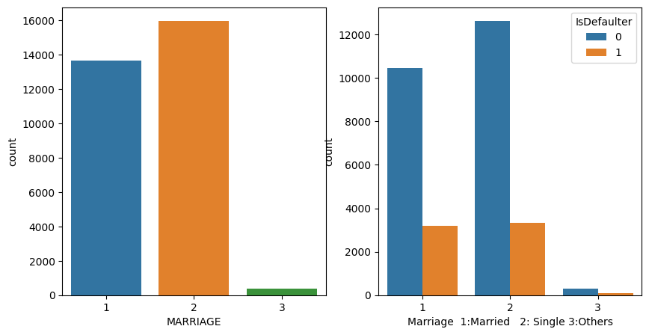
EDA (Continued)
Number of credit card holder is extreme in singles.
But credit card defaults are almost same in case of single and married
people.

Slide 13
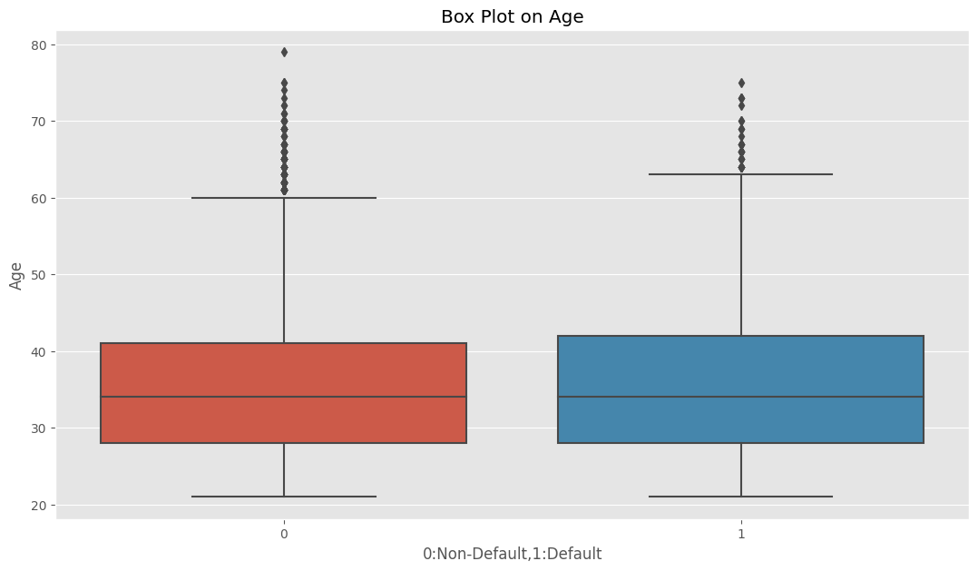
EDA (Continued)
This chart describes the age group of most number of users
Major number of users are aged from 30 to 40 years and even defaulters are in the same group

Slide 14
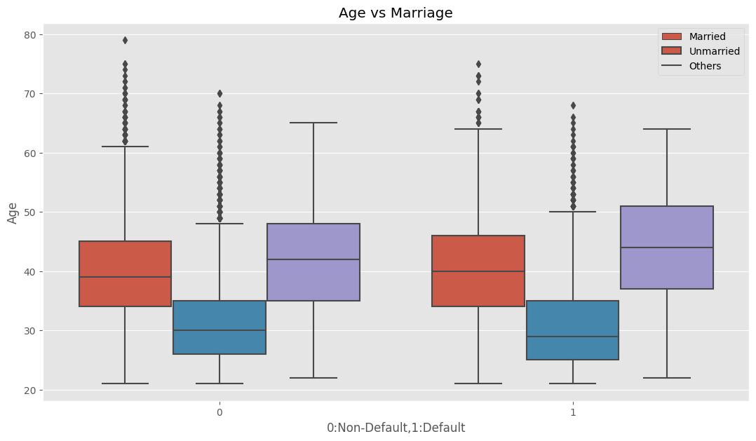
EDA (Continued)
This multivariate analysis helps us to get diverse age group according to their marital status.
Most married users using credit cards are aged between 35 to 45 and unmarried users are aged between 25 to 35. where as others are aged between 35 to 50,and that can be possible that they are married users.
The age group is same in both cases. so it does not give any business effect.

Slide 15
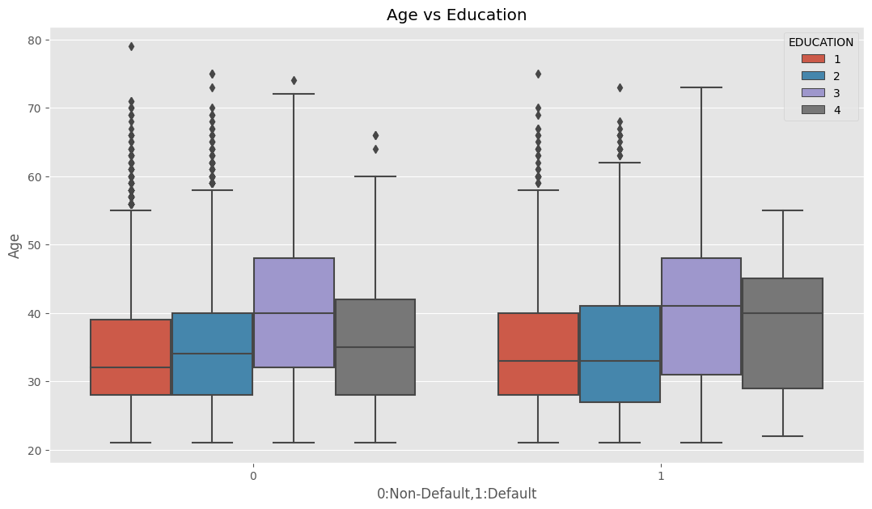
EDA (Continued)
It represents the age group on the basis of education.
High school group is aged more, ranges from 35 to 45 and it lean towards to default the same.

Slide 16
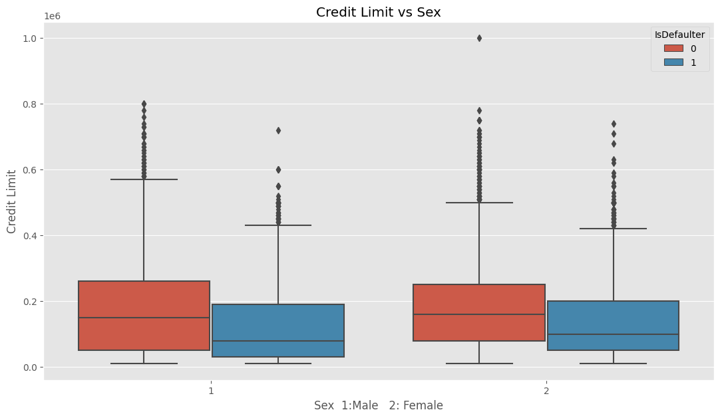
EDA (Continued)
This chart indicate us the major difference between defaulters and no defaulters credit range while considering the sex.
Defaulters have less credit limit than non defaulters not going above 20000 Dollars.
Users with less limit tend to default more, Banks can create the lower limit so that some defaulters can be removed.

Slide 17
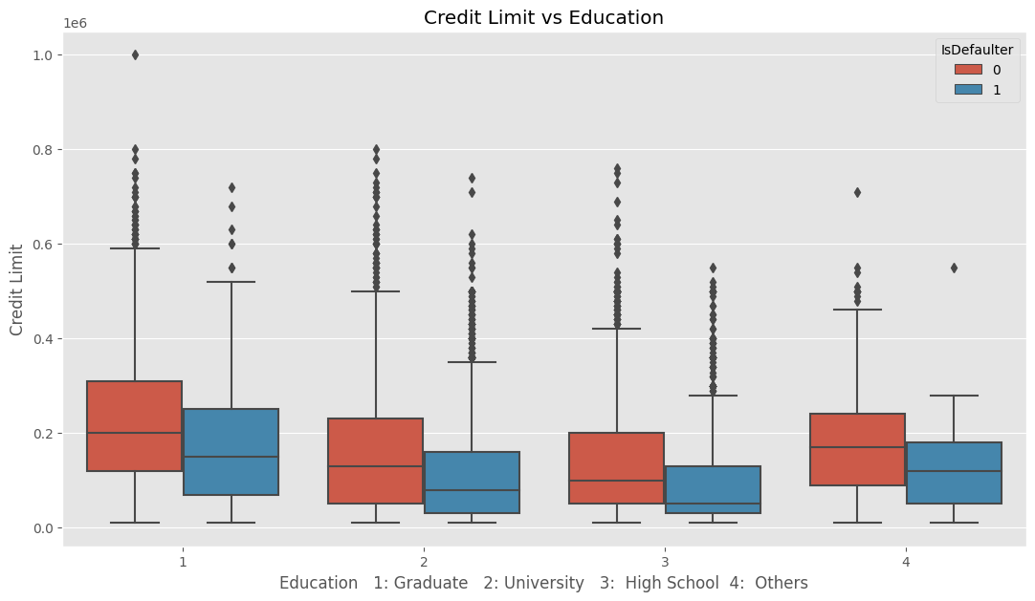
EDA (Continued)
This chart indicate the credit limit of different education group while considering the default payment.
Credit limit is majorly more in graduated users and lowest in high school users.

Slide 18
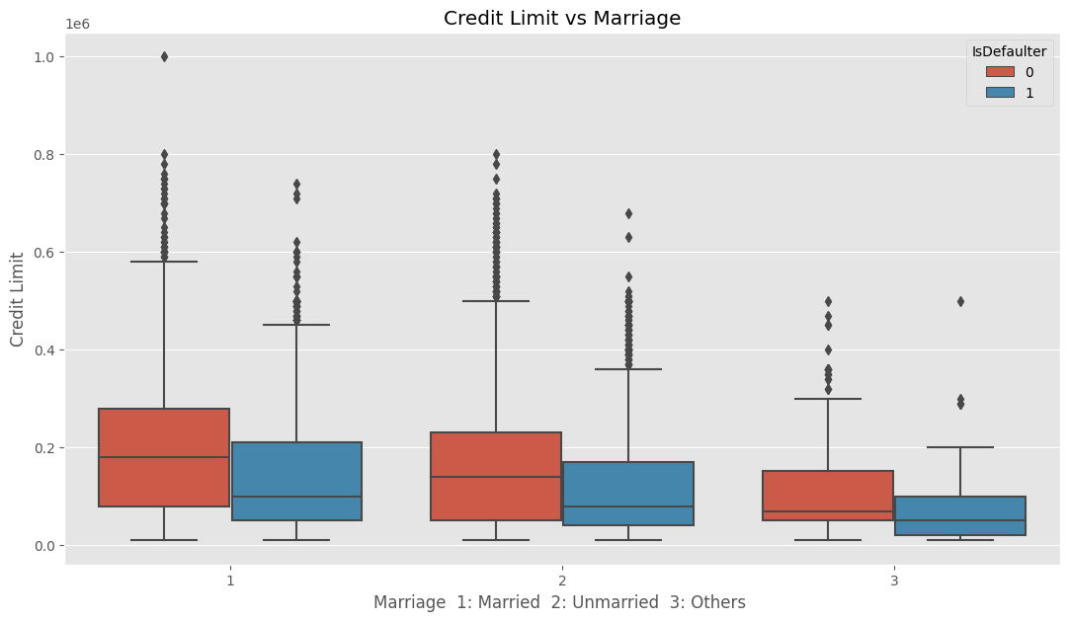
EDA (Continued)
This chart indicate credit limit of users of different marital status while considering the defaults
Married user tend to have more credit limit than unmarried users, defaulters in married users do have more credit limit.
A lower limit should be definite, when issuing a credit card with less amount, a background check should reticle followed.

Slide 19
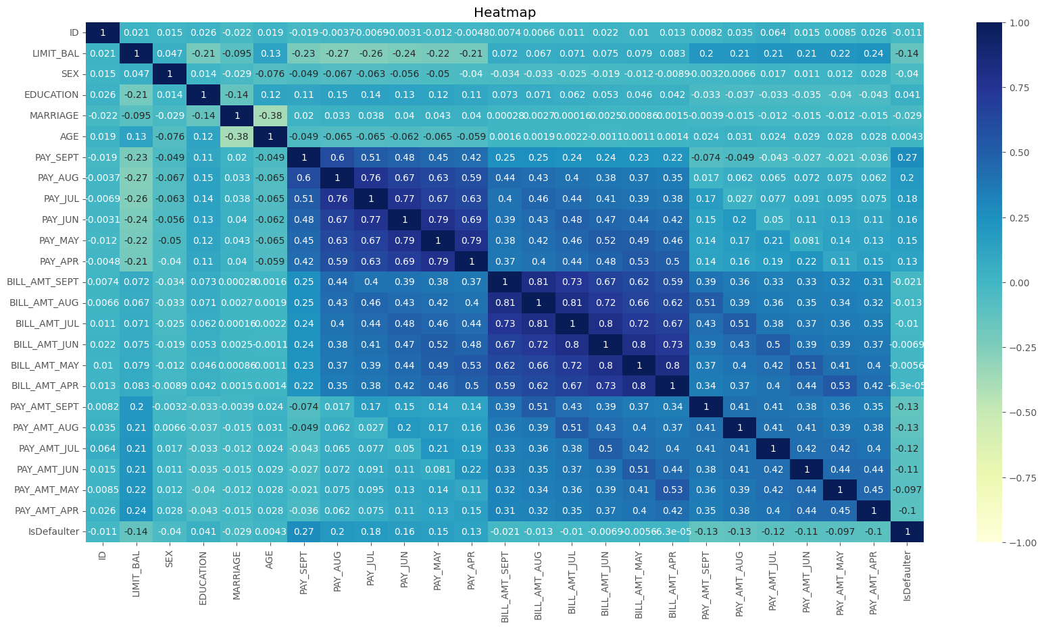
EDA (Continued)
This chart indicate the correlation between each factors.
There is not strong correlation between features except bill amount and payment made, that totally create sense.

Slide 20
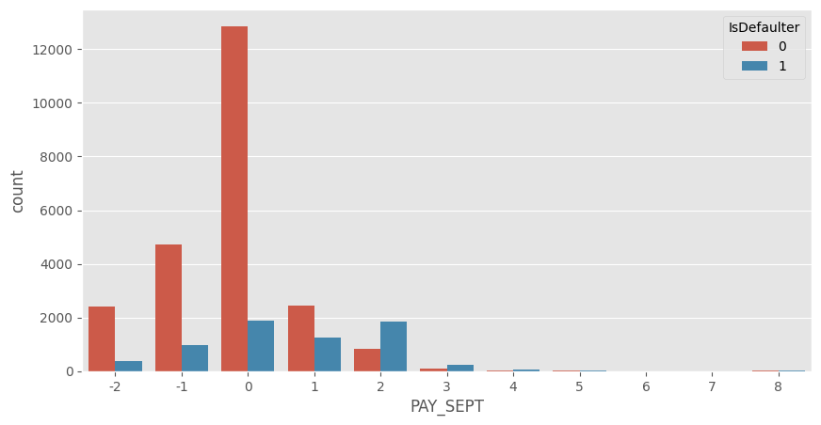
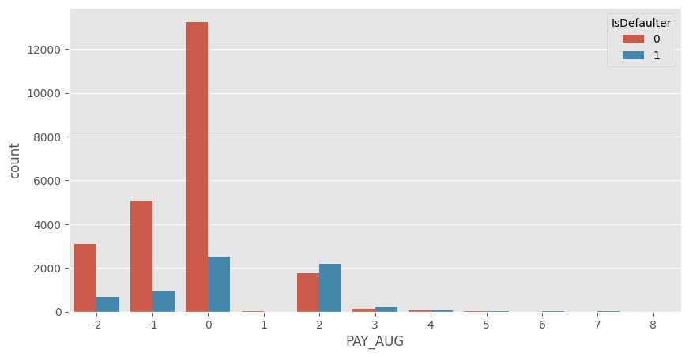
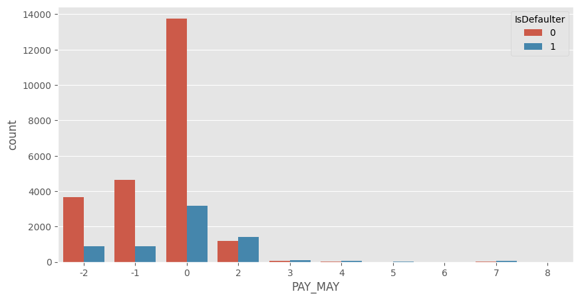

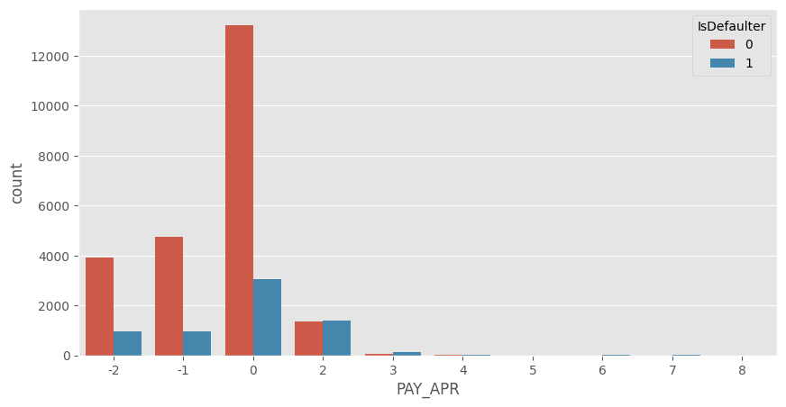
EDA (Continued)

Slide 21
EDA (Continued)
The above figure shows bar plot for each month payment status which display the count of defaulters and non-defaulter.
Most of the payments are paid properly, Majority time delayed to pay is 2 months.
delay after 2 months should not be accepted and user can be charged.

Slide 22

Transformation Of Data
To scale data into a unvarying format that would allow us to operate the data in a better way.
For performing fitting and applying diverse algorithms to it.
The basic goal was to impose a level of regularity or uniformity to dataset.

Slide 23
Splitting Data
Data splits into training dataset and testing dataset.
Training dataset is used to fit the machine learning model.
Test dataset is used to evaluate the fit machine learning model.
Here 70% of data taken as training dataset & remaining 30% of
dataset used for testing purpose.

Slide 24
Fitting Different Model
Following classifiers are used for predicting credit card default:
Logistic Regression
K-Nearest Neighbors
Naive Bayes
XG Boost Classifier
Random Forest Classifier

Slide 25
Cross Validation & Hyperparameter Tunning
It is a resampling procedure used to evaluate machine learning models on a limited data sample.
Basically, Cross Validation is a technique using which Model is evaluated on the dataset on which it is not trained that is it can be a test data or can be another set as per feasibility.
  Tuning the hyperparameters of particular algorithms is necessary for getting better accuracy and to avoid overfitting.

Slide 26
Different Models
1. Logistic Regression
Logistic regression is a machine learning algorithm for classification problem.
It is a predictive analysis algorithm and based on the concept of probability.
It is most useful for considerate the influence of some independent variables
on a single outcome variable.
Logistic Regression
Accuracy |  | Precision | Recall | F1 | ROC
Baseline Model | 0.802 | 0.702 | 0.189 | 0.297 | 0.583
Tunned Model | 0.802 | 0.702 | 0.189 | 0.297 | 0.583

Slide 27
2. K-Nearest Neighbors Classifier
K-Nearest Neighbour is one of the simplest Machine Learning algorithms which is based on Supervised Learning technique.
K-NN algorithm stores all the accessible data and classifies a new data point based on the similarity.
K-NN algorithm can be used for Regression as well as for Classification but mostly it is used for the Classification problems.
K-Nearest Neighbors
Accuracy |  | Precision | Recall | F1 | ROC
Baseline Model | 0.763 | 0.323 | 0.057 | 0.097 | 0.511
Tunned Model | 0.777 | 0.000 | 0.000 | 0.000 | 0.499

Slide 28
3. XGBoost Classifier
XG Boost is a decision-tree-based ensemble Machine Learning algorithm that uses a gradient boosting framework.
• It is a perfect grouping of software and hardware optimization techniques to produce higher results using less computing capitals in the shortest amount of time.
XGBoost Classifier
 | Accuracy | Precision | Recall | F1 | ROC
Baseline Model | 0.811 | 0.637 | 0.349 | 0.451 | 0.646
Tunned Model | 0.817 | 0.670 | 0.347 | 0.457 | 0.649

Slide 29
4. Random Forest Classifier
Random Forest is a classifier that comprises a number of decision trees on many subsets of the given dataset and takes the average to improve the predictive accuracy of that dataset.
Random Forest Classifier
 | Accuracy | Precision | Recall | F1 | ROC
Baseline Model | 0.814 | 0.654 | 0.353 | 0.459 | 0.650
Tunned Model | 0.816 | 0.658 | 0.363 | 0.467 | 0.654

Slide 30
Comparison of Model
Model | Accuracy | Precision | Recall | F1 Score | ROC
Logistic Regression | 0.802000 | 0.702602 | 0.1890 | 0.297872 | 0.583071
Logistic Regression Tuned | 0.802000 | 0.702602 | 0.1890 | 0.297872 | 0.583071
K-Nearest Neighbour | 0.763778 | 0.323034 | 0.0575 | 0.097623 | 0.511536
KNN Model Tuned | 0.776667 | 0.250000 | 0.0025 | 0.004950 | 0.500179
Gaussian Naive Bayes | 0.765333 | 0.476628 | 0.5710 | 0.519563 | 0.695929
Random tree Classifier | 0.814889 | 0.654630 | 0.3535 | 0.459091 | 0.650107
Random Forest Tuned | 0.816556 | 0.658205 | 0.3630 | 0.467934 | 0.654571
XGBOOST Classifier | 0.811222 | 0.637192 | 0.3495 | 0.451405 | 0.646321
XGBOOST Tuned | 0.818111 | 0.674017 | 0.3515 | 0.462044 | 0.651464

Slide 31
Conclusion
1. From all baseline model, Random Forest classifier and XG Boost shows highest test accuracy
2.XG Boost shows highest test accuracy score of 81% and ROC is 0.649.
3.Naive Bayes model performs the best in Recall.
4.Pay_0 feature is most responsible to make default payment.
5.Other Pay_ features are also most responsible to prevent default payment.
6. Cross validation and hyperparameter tunning surely reduces chances of overfitting and also enhance the performance of model.

